Slide 1
Database

Slide 2
What is Data?
Data is a collection of a distinct small unit of information. It can be used in a variety of forms like text, numbers, media, bytes, etc. it can be stored in pieces of paper or electronic memory, etc.
Word 'Data' is originated from the word 'datum' that means 'single piece of information.' It is plural of the word datum.
What is Database?
A database is an organized collection of data, so that it can be easily accessed and managed.

Slide 3
The Concept of Database Management System
Database management system is a software which is used to manage the database. For example: MySQL, Oracle, etc are a very popular commercial database which is used in different applications.
DBMS provides an interface to perform various operations like database creation, storing data in it, updating data, creating a table in the database and a lot more.
It provides protection and security to the database. In the case of multiple users, it also maintains data consistency.

Slide 4
For example: The college Database organizes the data about the admin, staff, students and faculty etc.
Using the database, you can easily retrieve, insert, and delete the information.

Slide 5
DATABASE APPLICATIONS – DBMS:
Telecom: There is a database to keeps track of the information regarding calls made, network usage, customer details etc.
• Industry: Where it is a manufacturing unit, warehouse or distribution centre, each one needs a database to keep the records of ins and outs
• Banking System: For storing customer info, tracking day to day credit and debit transactions, generating bank statements etc.
Sales: To store customer information, production information and invoice details.

Slide 6
Airlines: To travel though airlines, we make early reservations; this reservation information along with flight schedule is stored in database.
Education sector: Database systems are frequently used in schools and colleges tostore and retrieve the data regarding student details, staff details, course details, examdetails, payroll data, attendance details, fees details etc.

Slide 7
DBMS allows users the following tasks:
Data Definition: It is used for creation, modification, and removal of definition that defines the organization of data in the database.
Data Updation: It is used for the insertion, modification, and deletion of the actual data in the database.
Data Retrieval: It is used to retrieve the data from the database which can be used by applications for various purposes.
User Administration: It is used for registering and monitoring users, maintain data integrity, enforcing data security, monitoring performance and recovering information corrupted by unexpected failure.

Slide 8
Characteristics of DBMS
It uses a digital repository established on a server to store and manage the information.
DBMS contains automatic backup and recovery procedures.
It can reduce the complex relationship between data.
It is used to support manipulation and processing of data.
It is used to provide security of data.
It can view the database from different viewpoints according to the requirements of the user.

Slide 9
Advantages of DBMS
Controls database redundancy: It can control data redundancy because it stores all the data in one single database file and that recorded data is placed in the database.
Data sharing: In DBMS, the authorized users of an organization can share the data among multiple users.
Easily Maintenance: It can be easily maintainable due to the centralized nature of the database system.

Slide 10
Reduce time: It reduces development time and maintenance need.
Backup: It provides backup and recovery subsystems which create automatic backup of data from hardware and software failures and restores the data if required.
multiple user interface: It provides different types of user interfaces like graphical user interfaces, application program interfaces

Slide 11
Disadvantages of DBMS
Cost of Hardware and Software: It requires a high speed of data processor and large memory size to run DBMS software.
Size: It occupies a large space of disks and large memory to run them efficiently.
Higher impact of failure: Failure is highly impacted the database because in most of the organization, all the data stored in a single database and if the database is damaged due to electric failure or database corruption then the data may be lost forever.

Slide 12
You can organize data into tables, rows, columns, and index it to make it easier to find relevant information.
Database handlers create a database in such a way that only one set of software program provides access of data to all the users.
The main purpose of the database is to operate a large amount of information by storing, retrieving, and managing data.
There are many dynamic websites on the World Wide Web nowadays which are handled through databases. For example, a model that checks the availability of rooms in a hotel. It is an example of a dynamic website that uses a database.
There are many databases available like MySQL, Sybase, Oracle, MongoDB, Informix, PostgreSQL, SQL Server, etc.

Slide 13
Database Models
A Database model defines the logical design and structure of a database and defines how data will be stored, accessed and updated in a database management system.
Data models define how data is connected to each other and how they are processed and stored inside the system.
Hierarchical Model
Network Model
Entity-relationship Model
Relational Model

Slide 14
Hierarchical Model
This database model organises data into a tree-like-structure, with a single root, to which all the other data is linked. The heirarchy starts from the Root data, and expands like a tree, adding child nodes to the parent nodes.
In this model, a child node will only have a single parent node.
This model efficiently describes many real-world relationships like index of a book, recipes etc.
In hierarchical model, data is organised into tree-like structure with one one-to-many relationship between two different types of data, for example, one department can have many courses.

Slide 15
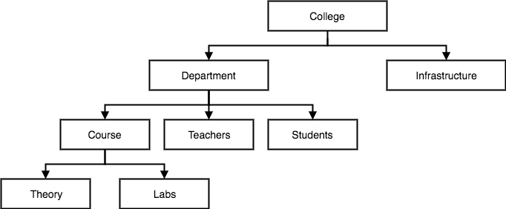

Slide 16
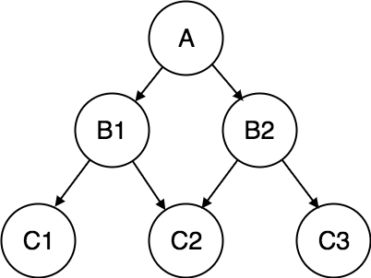
Network Model
This is an extension of the Hierarchical model. In this model data is organised more like a graph, and are allowed to have more than one parent node.
In this database model data is more related as more relationships are established in this database model. Also, as the data is more related, hence accessing the data is also easier and fast. This database model was used to map many-to-many data relationships

Slide 17
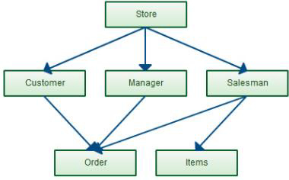
Inventory database

Slide 18
Advantages
The advantages of network model are as follows:
Network models represent complex data relationships better than the hierarchical models.
It handles so many relationship types.
Data access is more flexible than hierarchical models.

Slide 19
Entity-relationship Model
In this database model, relationships are created by dividing object of interest into entity and its characteristics into attributes.
Different entities are related using relationships.
E-R Models are defined to represent the relationships into pictorial form to make it easier for different stakeholders to understand.
This model is good to design a database, which can then be turned into tables in relational model.
Let's take an example, If we have to design a School Database, then Student will be an entity with attributes name, age, address etc. As Address is generally complex, it can be another entity with attributes street name, pincode, city etc, and there will be a relationship between them.

Slide 20
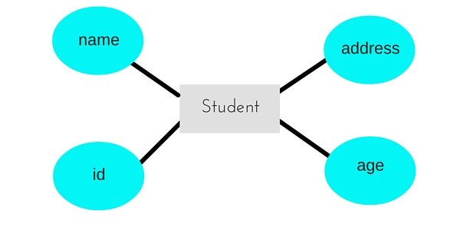
Relationships can also be of different types. To learn about E-R Diagrams in details, click on the link.

Slide 21
Relational Model
In this model, data is organised in two-dimensional tables and the relationship is maintained by storing a common field.
This model was introduced by E.F Codd in 1970, and since then it has been the most widely used database model, infact, we can say the only database model used around the world.
The basic structure of data in the relational model is tables. All the information related to a particular type is stored in rows of that table.
Hence, tables are also known as relations in relational model.
Each row is known as a tuple. Each table of the column has a name or attribute.

Slide 22
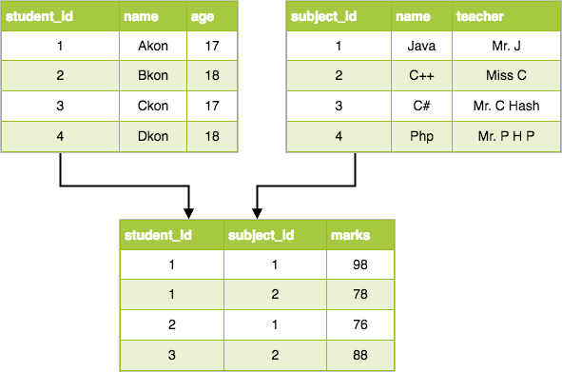
Student

Slide 23
Properties of Relations
Name of the relation is distinct from all other relations.
Each relation cell contains exactly one atomic (single) value
Each attribute contains a distinct name
Attribute domain has no significance
tuple has no duplicate value

Slide 24
What is RDBMS (Relational Database Management System)
RDBMS stands for Relational Database Management System.
All modern database management systems like SQL, MS SQL Server, IBM DB2, ORACLE, My-SQL, and Microsoft Access are based on RDBMS.
It is called Relational Database Management System (RDBMS) because it is based on the relational model introduced by E.F. Codd.
Relational DBMS owes its foundation to the fact that the values of each table are related to others. It has the capability to handle larger magnitudes of data and simulate queries easily.
A relational database is the most commonly used database. It contains several tables, and each table has its primary key.
Due to a collection of an organized set of tables, data can be accessed easily in RDBMS.

Slide 25
What is table/Relation?
Everything in a relational database is stored in the form of relations.
The RDBMS database uses tables to store data. A table is a collection of related data entries and contains rows and columns to store data.

Slide 26
Properties of a Relation:
Each relation has a unique name by which it is identified in the database.
Relation does not contain duplicate tuples.
The tuples of a relation have no specific order.
All attributes in a relation are atomic, i.e., each cell of a relation contains exactly one value.

Slide 27
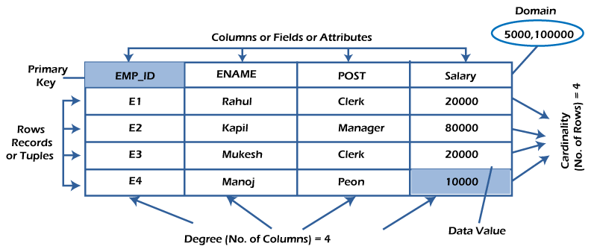

Slide 28
Relational Database Management Systems maintains data integrity by simulating the following features:
Entity Integrity: No two records of the database table can be completely duplicate.
Referential Integrity: Only the rows of those tables can be deleted which are not used by other tables. Otherwise, it may lead to data inconsistency.
User-defined Integrity: Rules defined by the users based on confidentiality and access.
Domain integrity: The columns of the database tables are enclosed within some structured limits, based on default values, type of data or ranges.

Slide 29
Relational Model Concepts
1. Attribute:
Each column in a Table. Attributes are the properties which define a relation. e.g., Student_Rollno, NAME,
2. Tables –
In the Relational model the, relations are saved in the table format. It is stored along with its entities. A table has two properties rows and columns. Rows represent records and columns represent attributes.
3. Tuple –
It is nothing but a single row of a table, which contains a single record.
4. Relation Schema:
A relation schema represents the name of the relation with its attributes.etc

Slide 30
5. Degree:
The total number of attributes which in the relation is called the degree of the relation.
6. Cardinality:
Total number of rows present in the Table.
7. Column:
The column represents the set of values for a specific attribute.

Slide 31
Keys in DBMS
KEYS in DBMS is an attribute or set of attributes which helps you to identify a row(tuple) in a relation(table).
They allow you to find the relation between two tables.
Key is also helpful for finding unique record or row from the table. Database key is also helpful for finding unique record or row from the table.

Slide 32
Types of Keys
• Super Key - A super key is a group of single or multiple keys which identifies rows in a table.
• Primary Key - is a column or group of columns in a table that uniquely identify every row in that table.
• Candidate Key - is a set of attributes that uniquely identify tuples in a table. Candidate Key is a super key with no repeated attributes.
• Alternate Key - is a column or group of columns in a table that uniquely identify every row in that table.
• Foreign Key - is a column that creates a relationship between two tables. The purpose of Foreign keys is to maintain data integrity and allow navigation between two different instances of an entity.

Slide 33
Characteristics
Data must be stored in tabular form in DB file, that is, it should be organized in the form of rows and columns.
Each row of table is called record/tuple . Collection of such records is known as the cardinality of the table
Each column of the table is called an attribute/field.
No two records of the DB table can be same. Data duplicity is therefore avoided by using a candidate key.
Tables are related to each other with the help for foreign keys.
Database tables also allow NULL values, that is if the values of any of the element of the table are not filled or are missing, it becomes a NULL value, which is not equivalent to zero. (NOTE: Primary key cannot have a NULL value).

Slide 34
Example: The following table STUDENT consists of three columns Roll Number, Name, Section and four records of students 1, 2, 3 and 4 respectively. The records can’t be completely same, the Roll Number acts as a candidate key which separates records.
Roll number | Name | Section
1 | Ishita | A
2 | Yash | B
3 | Ishita | A
4 | Mallika | C

Slide 35
Advantages
Easy to manage: Each table can be independently manipulated without affecting others.
Security: It is more secure consisting of multiple levels of security. Access of data shared can be limited.
Flexible: Updating of data can be done at a single point without making amendments at multiple files. Databases can easily be extended to incorporate more records, thus providing greater scalability. Also, facilitates easy application of SQL queries.
Users: RDBMS supports client-side architecture storing multiple users together.
Facilitates storage and retrieval of large amount of data.
Easy Data Handling:
Data fetching is faster because of relational architecture.
Data redundancy or duplicity is avoided due to keys, indexes, and normalization principles.
Data consistency is ensured because RDBMS is based on ACID properties for data transactions(Atomicity Consistency Isolation Durability).
Fault Tolerance: Replication of databases provides simultaneous access and helps the system recover in case of disasters, such as power failures or sudden shutdowns

Slide 36
Disadvantages
High Cost and Extensive Hardware and Software Support: Huge costs and setups are required to make these systems functional.
Scalability: In case of addition of more data, servers along with additional power, and memory are required.
Complexity: Voluminous data creates complexity in understanding of relations and may lower down the performance.
Structured Limits: The fields or columns of a relational database system is enclosed within various limits, which may lead to loss of data

Slide 37
Properties of relational databases
Relational Database Management Systems (RDBMS) are efficient and a common choice for storing financial records, logistical information, personnel data, and other information in new databases. Because they are easier to understand and use than NoSQL databases, relational databases also frequently replace legacy hierarchical databases and network databases.
Values are atomic.
All of the values in a column have the same data type.
Each row is unique.
Each column has a unique name.
Integrity constraints maintain data consistency across multiple tables.

Slide 38
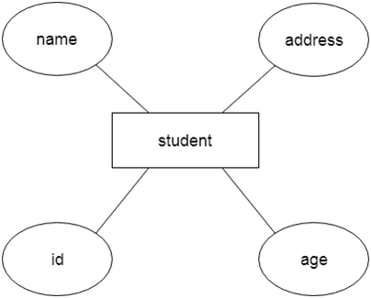
ER model
ER model stands for an Entity-Relationship model. It is a high-level data model. This model is used to define the data elements and relationship for a specified system.
It develops a conceptual design for the database. It also develops a very simple and easy to design view of data.
In ER modeling, the database structure is portrayed as a diagram called an entity-relationship diagram.
For example, Suppose we design a school database. In this database, the student will be an entity with attributes like address, name, id, age, etc. The address can be another entity with attributes like city, street name, pin code, etc and there will be a relationship between them.

Slide 39
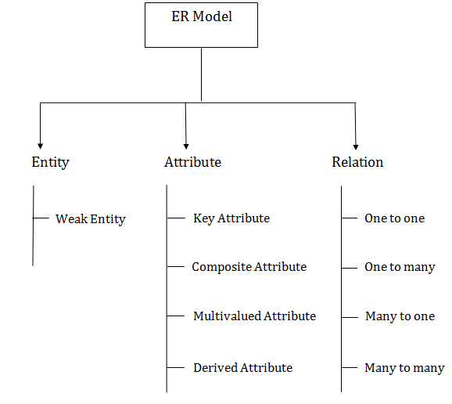
Component of ER Diagram

Slide 40

1. Entity:
An entity may be any object, class, person or place. In the ER diagram, an entity can be represented as rectangles.
Consider an organization as an example- manager, product, employee, department etc. can be taken as an entity.

Slide 41
a. Weak Entity
An entity that depends on another entity called a weak entity. The weak entity doesn't contain any key attribute of its own. The weak entity is represented by a double rectangle.

Slide 42
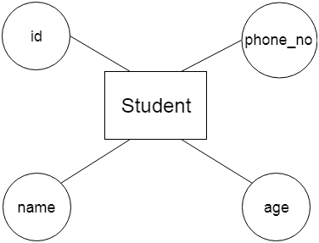
2. Attribute
The attribute is used to describe the property of an entity. Eclipse is used to represent an attribute.
For example, id, age, contact number, name, etc. can be attributes of a student.

Slide 43
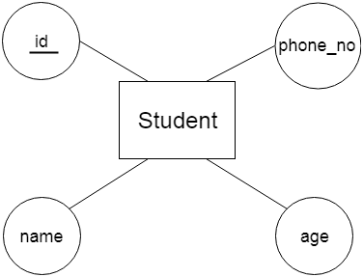
a. Key Attribute
The key attribute is used to represent the main characteristics of an entity. It represents a primary key. The key attribute is represented by an ellipse with the text underlined.

Slide 44
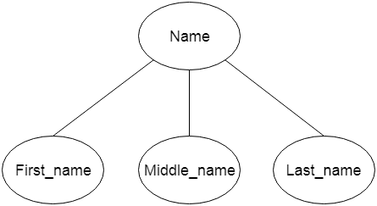
b. Composite Attribute
An attribute that composed of many other attributes is known as a composite attribute. The composite attribute is represented by an ellipse, and those ellipses are connected with an ellipse.

Slide 45
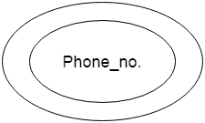
c. Multivalued Attribute
An attribute can have more than one value. These attributes are known as a multivalued attribute. The double oval is used to represent multivalued attribute.
For example, a student can have more than one phone number.
An attribute can have more than one value. These attributes are known as a multivalued attribute. The double oval is used to represent multivalued attribute.
For example, a student can have more than one phone number.

Slide 46
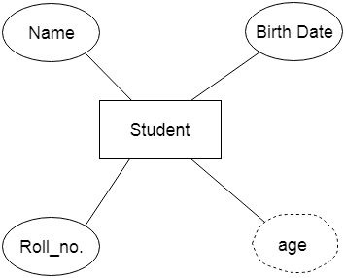
d. Derived Attribute
An attribute that can be derived from other attribute is known as a derived attribute. It can be represented by a dashed ellipse.
For example, A person's age changes over time and can be derived from another attribute like Date of birth.

Slide 47

3. Relationship
A relationship is used to describe the relation between entities. Diamond or rhombus is used to represent the relationship.

Slide 48

Types of relationship are as follows: a. One-to-One Relationship
When only one instance of an entity is associated with the relationship, then it is known as one to one relationship.
For example, A female can marry to one male, and a male can marry to one female.

Slide 49

b. One-to-many relationship
When only one instance of the entity on the left, and more than one instance of an entity on the right associates with the relationship then this is known as a one-to-many relationship.
For example, Scientist can invent many inventions, but the invention is done by the only specific scientist.

Slide 50

c. Many-to-one relationship
When more than one instance of the entity on the left, and only one instance of an entity on the right associates with the relationship then it is known as a many-to-one relationship.
For example, Student enrolls for only one course, but a course can have many students.

Slide 51

d. Many-to-many relationship
When more than one instance of the entity on the left, and more than one instance of an entity on the right associates with the relationship then it is known as a many-to-many relationship.
For example, Employee can assign by many projects and project can have many employees.

Slide 52
What is Normalization?
Normalization is the process of organizing the data in the database.
Normalization is used to minimize the redundancy from a relation or set of relations. It is also used to eliminate undesirable characteristics like Insertion, Update, and Deletion Anomalies.
Normalization divides the larger table into smaller and links them using relationships.
The normal form is used to reduce redundancy from the database table.

Slide 53
Advantages of Normalization
Normalization helps to minimize data redundancy.
Greater overall database organization.
Data consistency within the database.
Much more flexible database design.
Enforces the concept of relational integrity.

Slide 54
Disadvantages of Normalization
You cannot start building the database before knowing what the user needs.
It is very time-consuming and difficult to normalize relations of a higher degree.
Careless decomposition may lead to a bad database design, leading to serious problems.

Slide 55
Types of Normal Forms:
Normal Form | Description
1NF | A relation is in 1NF if it contains an atomic value.
2NF | A relation will be in 2NF if it is in 1NF and all non-key attributes are fully functional dependent on the primary key.
3NF | A relation will be in 3NF if it is in 2NF and no transition dependency exists.
BCNF | A stronger definition of 3NF is known as Boyce Codd's normal form.
4NF | A relation will be in 4NF if it is in Boyce Codd's normal form and has no multi-valued dependency.
5NF | A relation is in 5NF. If it is in 4NF and does not contain any join dependency, joining should be lossless.

Slide 56
First Normal Form (1NF)
A relation will be 1NF if it contains an atomic value.
It states that an attribute of a table cannot hold multiple values. It must hold only single-valued attribute.
First normal form disallows the multi-valued attribute, composite attribute, and their combinations.
Example: Relation EMPLOYEE is not in 1NF because of multi-valued attribute EMP_PHONE.
EMPLOYEE table:

Slide 57
The decomposition of the EMPLOYEE table into 1NF has been shown below
EMP_ID | EMP_NAME | EMP_PHONE | EMP_STATE
14 | John | 7272826385, 9064738238 | UP
20 | Harry | 8574783832 | Bihar
12 | Sam | 7390372389, 8589830302 | Punjab

Slide 58
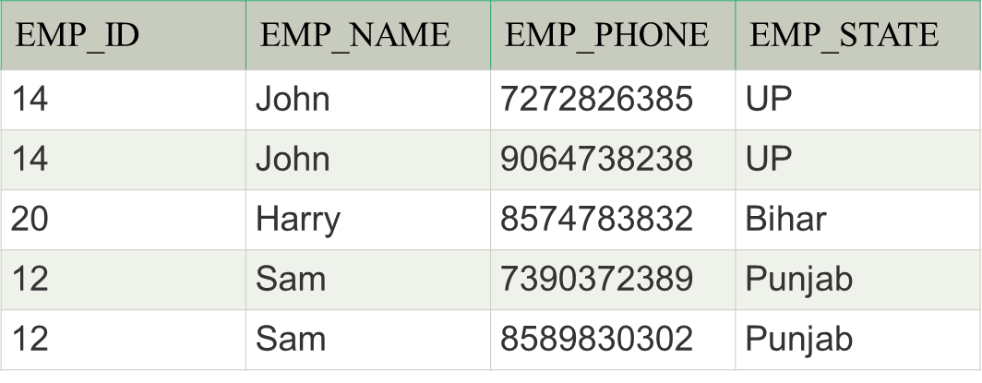

Slide 59
Second Normal Form (2NF)
In the 2NF, relational must be in 1NF.
In the second normal form, all non-key attributes are fully functional dependent on the primary key
Example: Let's assume, a school can store the data of teachers and the subjects they teach. In a school, a teacher can teach more than one subject.
TEACHER table

Slide 60
TEACHER_ID | SUBJECT | TEACHER_AGE
25 | Chemistry | 30
25 | Biology | 30
47 | English | 35
83 | Math | 38
83 | Computer | 38

Slide 61
In the given table, non-prime attribute TEACHER_AGE is dependent on TEACHER_ID which is a proper subset of a candidate key. That's why it violates the rule for 2NF.
To convert the given table into 2NF, we decompose it into two tables

Slide 62
TEACHER_DETAIL table:
TEACHER_ID | TEACHER_AGE
25 | 30
47 | 35
83 | 38

Slide 63
TEACHER_SUBJECT table:
TEACHER_ID | SUBJECT
25 | Chemistry
25 | Biology
47 | English
83 | Math
83 | Computer

Slide 64
Third Normal Form (3NF)
A relation will be in 3NF if it is in 2NF and not contain any transitive partial dependency.
3NF is used to reduce the data duplication. It is also used to achieve the data integrity.
If there is no transitive dependency for non-prime attributes, then the relation must be in third normal form.
A relation is in third normal form if it holds atleast one of the following conditions for every non-trivial function dependency X → Y.
X is a super key.
Y is a prime attribute, i.e., each element of Y is part of some candidate key.
Example:

Slide 65
EMPLOYEE_DETAIL table:
EMP_ID | EMP_NAME | EMP_ZIP | EMP_STATE | EMP_CITY
222 | Harry | 201010 | UP | Noida
333 | Stephan | 02228 | US | Boston
444 | Lan | 60007 | US | Chicago
555 | Katharine | 06389 | UK | Norwich
666 | John | 462007 | MP | Bhopal

Slide 66
Candidate key: {EMP_ID}
Non-prime attributes: In the given table, all attributes except EMP_ID are non-prime.
Here, EMP_STATE & EMP_CITY dependent on EMP_ZIP and EMP_ZIP dependent on EMP_ID. The non-prime attributes (EMP_STATE, EMP_CITY) transitively dependent on super key(EMP_ID). It violates the rule of third normal form.
That's why we need to move the EMP_CITY and EMP_STATE to the new <EMPLOYEE_ZIP> table, with EMP_ZIP as a Primary key.

Slide 67
EMPLOYEE table:
EMP_ID | EMP_NAME | EMP_ZIP
222 | Harry | 201010
333 | Stephan | 02228
444 | Lan | 60007
555 | Katharine | 06389
666 | John | 462007

Slide 68
EMPLOYEE_ZIP table:
EMP_ZIP | EMP_STATE | EMP_CITY
201010 | UP | Noida
02228 | US | Boston
60007 | US | Chicago
06389 | UK | Norwich
462007 | MP | Bhopal

Slide 69
EMPLOYEE table:
EMP_ID | EMP_COUNTRY | EMP_DEPT | DEPT_TYPE | EMP_DEPT_NO
264 | India | Designing | D394 | 283
264 | India | Testing | D394 | 300
364 | UK | Stores | D283 | 232
364 | UK | Developing | D283 | 549

Slide 70
Boyce Codd normal form (BCNF)
BCNF is the advance version of 3NF. It is stricter than 3NF.
A table is in BCNF if every functional dependency X → Y, X is the super key of the table.
For BCNF, the table should be in 3NF, and for every FD, LHS is super key.
Example: Let's assume there is a company where employees work in more than one department.

Slide 71
In the table Functional dependencies are as follows:
EMP_ID → EMP_COUNTRY
EMP_DEPT → {DEPT_TYPE, EMP_DEPT_NO}
EMP_ID | EMP_COUNTRY | EMP_DEPT | DEPT_TYPE | EMP_DEPT_NO
264 | India | Designing | D394 | 283
264 | India | Testing | D394 | 300
364 | UK | Stores | D283 | 232
364 | UK | Developing | D283 | 549

Slide 72
EMP_COUNTRY table:
The table is not in BCNF because neither EMP_DEPT nor EMP_ID alone are keys.
To convert the given table into BCNF, we decompose it into three tables:
EMP_ID | EMP_COUNTRY
264 | India
264 | India

Slide 73
EMP_DEPT table:
EMP_DEPT | DEPT_TYPE | EMP_DEPT_NO
Designing | D394 | 283
Testing | D394 | 300
Stores | D283 | 232
Developing | D283 | 549

Slide 74
EMP_DEPT_MAPPING table:
EMP_ID | EMP_DEPT
D394 | 283
D394 | 300
D283 | 232
D283 | 549

Slide 75
Fourth normal form (4NF)
A relation will be in 4NF if it is in Boyce Codd normal form and has no multi-valued dependency.
For a dependency A → B, if for a single value of A, multiple values of B exists, then the relation will be a multi-valued dependency.
Example

Slide 76
STUDENT
STU_ID | COURSE | HOBBY
21 | Computer | Dancing
21 | Math | Singing
34 | Chemistry | Dancing
74 | Biology | Cricket
59 | Physics | Hockey

Slide 77
he given STUDENT table is in 3NF, but the COURSE and HOBBY are two independent entity. Hence, there is no relationship between COURSE and HOBBY.
In the STUDENT relation, a student with STU_ID, 21 contains two courses, Computer and Math and two hobbies, Dancing and Singing. So there is a Multi-valued dependency on STU_ID, which leads to unnecessary repetition of data.
So to make the above table into 4NF, we can decompose it into two tabl

Slide 78
STUDENT_COURSE
STU_ID | COURSE
21 | Computer
21 | Math
34 | Chemistry
74 | Biology
59 | Physics

Slide 79
STUDENT_HOBBY
STU_ID | HOBBY
21 | Dancing
21 | Singing
34 | Dancing
74 | Cricket
59 | Hockey

Slide 80
Fifth normal form (5NF)
A relation is in 5NF if it is in 4NF and not contains any join dependency and joining should be lossless.
5NF is satisfied when all the tables are broken into as many tables as possible in order to avoid redundancy.
5NF is also known as Project-join normal form (PJ/NF).

Slide 81
UBJECT | LECTURER | SEMESTER
Computer | Anshika | Semester 1
Computer | John | Semester 1
Math | John | Semester 1
Math | Akash | Semester 2
Chemistry | Praveen | Semester 1

Slide 82
In the above table, John takes both Computer and Math class for Semester 1 but he doesn't take Math class for Semester 2. In this case, combination of all these fields required to identify a valid data.
Suppose we add a new Semester as Semester 3 but do not know about the subject and who will be taking that subject so we leave Lecturer and Subject as NULL. But all three columns together acts as a primary key, so we can't leave other two columns blank.
So to make the above table into 5NF, we can decompose it into three relations P1, P2 & P3:

Slide 83
P1
SEMESTER | SUBJECT
Semester 1 | Computer
Semester 1 | Math
Semester 1 | Chemistry
Semester 2 | Math

Slide 84
P2
SUBJECT | LECTURER
Computer | Anshika
Computer | John
Math | John
Math | Akash
Chemistry | Praveen

Slide 85
P3
SEMSTER | LECTURER
Semester 1 | Anshika
Semester 1 | John
Semester 1 | John
Semester 2 | Akash
Semester 1 | Praveen

Slide 86
Integrity Constraints
Integrity constraints are a set of rules. It is used to maintain the quality of information.
Integrity constraints ensure that the data insertion, updating, and other processes have to be performed in such a way that data integrity is not affected.
Thus, integrity constraint is used to guard against accidental damage to the database.
Types of Integrity Constraint

Slide 87
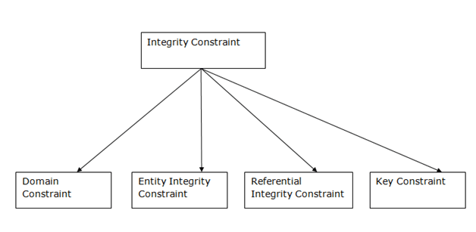

Slide 88
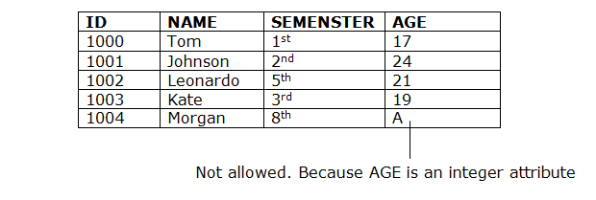
1. Domain constraints
Domain constraints can be defined as the definition of a valid set of values for an attribute.
The data type of domain includes string, character, integer, time, date, currency, etc. The value of the attribute must be available in the corresponding domain.

Slide 89
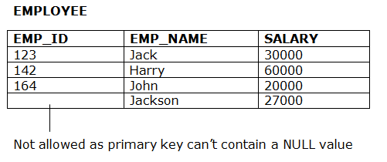
2. Entity integrity constraints
The entity integrity constraint states that primary key value can't be null.
This is because the primary key value is used to identify individual rows in relation and if the primary key has a null value, then we can't identify those rows.
A table can contain a null value other than the primary key field.

Slide 90
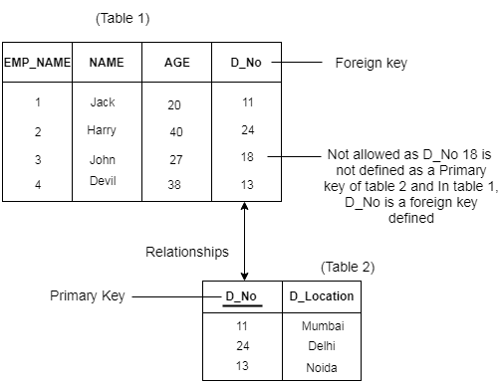
3. Referential Integrity Constraints
A referential integrity constraint is specified between two tables.
In the Referential integrity constraints, if a foreign key in Table 1 refers to the Primary Key of Table 2, then every value of the Foreign Key in Table 1 must be null or be available in Table 2.
Example:

Slide 91
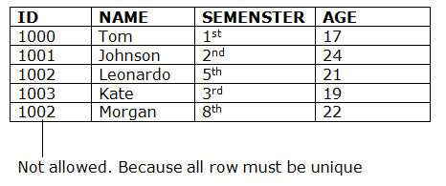
4. Key constraints
Keys are the entity set that is used to identify an entity within its entity set uniquely.
An entity set can have multiple keys, but out of which one key will be the primary key. A primary key can contain a unique and null value in the relational table.
Example:

Slide 92
Primary Key in DBMS
There are certain keys in DBMS that are used for different purposes, from which the most commonly known is the Primary Key.
Here, in this
What is a Primary Key
A Primary Key is the minimal set of attributes of a table that has the task to uniquely identify the rows, or we can say the tuples of the given particular table.
A primary key of a relation is one of the possible candidate keys which the database designer thinks it's primary. It may be selected for convenience, performance and many other reasons. The choice of the possible primary key from the candidate keys depend upon the following conditions.

Slide 93
Minimal: The primary key should be composed of the minimum number of attributes that satisfy unique occurrences of the tuples. So if one candidate key is formed using two attributes and another using a single attribute then the one with the single attribute key should be chosen as the primary key.
Accessible: The primary key used should be accessible by anyone who wants to use it. The user must easily insert, access or delete a tuple using it.
NON NULL Value: The primary key must have a non-null value for each tuple of the relation, which is required for the identification of the tuple.
Time Variant: The values of the primary key must not change or become null during the time of a relation.
Unique: The value of the primary key must not be duplicated in any of the tuples of a relation.

Slide 94
Syntax for creating primary key constraint:
The primary key constraint can be defined at the column level or table level.
At column level:
<column_name><datatype> Primary key;

Slide 95
Properties of a Primary Key:
A relation can contain only one primary key.
A primary key may be composed of a single attribute known as single primary key or more than one attribute known as composite key.
A primary key is the minimum super key.
The data values for the primary key attribute should not be null.
Attributes which are part of a primary key are known as Prime attributes.
Primary key is always chosen from the possible candidate keys.
If the primary key is made of more than one attribute then those attributes are irreducible.
We use the convention that the attribute that form primary key of relation is underlined.
Primary key cannot contain duplicate values.
Columns that are defined as LONG or LONG RAW cannot be part of a primary key.

Slide 96
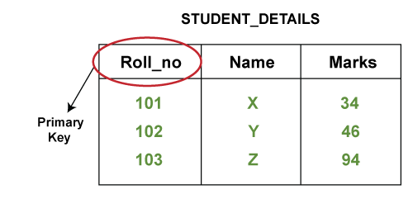
For example: When we store the registration details of the students in the database, we find the registration number field unique and assign the primary key to the field. Also, for an employee table, we set the primary key on the employee Id of the table.
Let's understand it practically:
Below is the table named STUDENT_DETAILS, where Roll_no, Name, and Marks are the specified attributes of it.
As we know that from these three attributes, the Roll_no attribute is the one that can uniquely identify other two attributes of the table as each student is provided with a unique roll number in every organization. So, we can set the primary key constraint on the Roll_no column.

Slide 97
Foreign Key in DBMS
A foreign key is different from a super key, candidate key or primary key because a foreign key is the one that is used to link two tables together or create connectivity between the two.
What is a Foreign Key
A foreign key is the one that is used to link two tables together via the primary key. It means the columns of one table points to the primary key attribute of the other table. It further means that if any attribute is set as a primary key attribute will work in another table as a foreign key attribute. But one should know that a foreign key has nothing to do with the primary key.
Use of Foreign Key
The use of a foreign key is simply to link the attributes of two tables together with the help of a primary key attribute. Thus, it is used for creating and maintaining the relationship between the two relations.

Slide 98
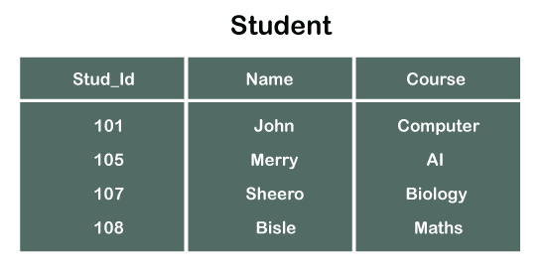
Example of Foreign Key
Let's discuss an example to understand the working of a foreign key.
Consider two tables Student and Department having their respective attributes as shown in the below table structure:

Slide 99
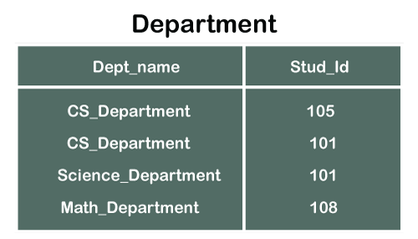

Slide 100
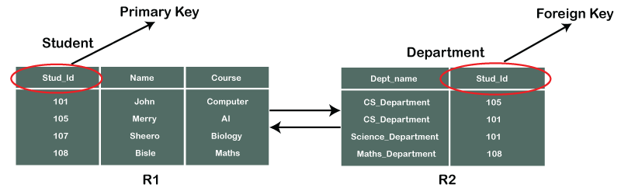
In the tables, one attribute, you can see, is common, that is Stud_Id, but it has different key constraints for both tables. In the Student table, the field Stud_Id is a primary key because it is uniquely identifying all other fields of the Student table. On the other hand, Stud_Id is a foreign key attribute for the Department table because it is acting as a primary key attribute for the Student table. It means that both the Student and Department table are linked with one another because of the Stud_Id attribute.
In the below-shown figure, you can view the following structure of the relationship between the two tables.

Slide 101
Creating Foreign Key constraint
On CREATE TABLE
Below is the syntax that will make us learn the creation of a foreign key in a table:
CREATE TABLE Department (
Dept_name varchar (120) NOT NULL,
Stud_Id int,
FOREIGN KEY (Stud_Id) REFERENCES Student (Stud_Id)
);

